Slide 1
How do you learn and teach a language?

Slide 2
Imagine you had to teach someone English.
Where would you start?
What are the essential things to know?
Would it work to go through the dictionary from A to Z until you knew every word?
Would it work to only speak it at them and never read or write?

Slide 3
Come up to the board and write any 5 words in English.
Make them have nothing to do with each other, some short, some long. As random as possible.
Ideally, open up a book and point at 5 words with your eyes closed

Slide 4
Can we put those random words into categories by similarity?
Let’s try to group them into 4 or 5 different groups. You can choose the criteria by which we group them. How would you do it?
Work with the people around you and decide how you will do it.

Slide 5
Luckily, if you’re not sure, language teachers have this figured out.
Actions | Things that describe actions | People and stuff | Things that describe people and stuff | Everything else

Slide 6
Those words were grouped that way because all words within the same category play by the same rules.
Actions | Things that describe actions | People and stuff | Things that describe people and stuff | Everything else
You can make them past, present, future, etc. You usually say who is doing it (I, you, he, she) They usually can take the word “to” (to go, to walk) or “-ing” (going, walking) | Usually end in –ly Describe the intensity of an action Come after an action word (he runs quickly) Can be used for comparison (he runs more quickly than she does) Some are irregular (he runs well) | Often refers to things you can physically touch (wall, book, apple) Can take the words “a, the, some, any, this, that” to show quantity (a book, the wall, this apple) Can change in spelling to show more than one (apples, books) | They tend to come right before the thing they describe (a black car, a good idea) You can use them for comparison (blacker, less important, as big as) You can stack them (a big scary black bear) | Words that were invented to link other words together Don’t have real-life references (you can’t draw them, easily describe them, or touch them) Words like: and, but, because, when, from…

Slide 7
Which of those categories do we start with?
Actions (verbs)
Describers of actions (adverbs)
Stuff/people (nouns)
Describers of stuff (adjectives)
Everything else (prepositions, conjunctions…)

Slide 8
Why verbs?
They’re the only category of word one that can be sentences on their own
I was walking = full sentence
Big brown = not a full sentence
They’re the most essential for storytelling
It’s really hard to tell someone what’s happening/what happened without describing the actual actions

Slide 9
To make sure you’re following…
Hit me with some examples of verbs in English.
For good measure, give me different forms of the word. Tell me what the spelling would be for the past or future tense.
Another way to think about it: you are playing scrabble. What letters can you add to make the word longer?

Slide 10
We need a verb to use as a model to introduce us to the wonderful world of verbs
TO WALK

Slide 11
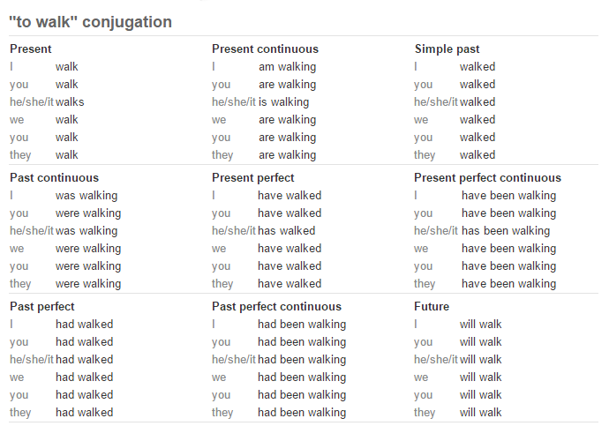
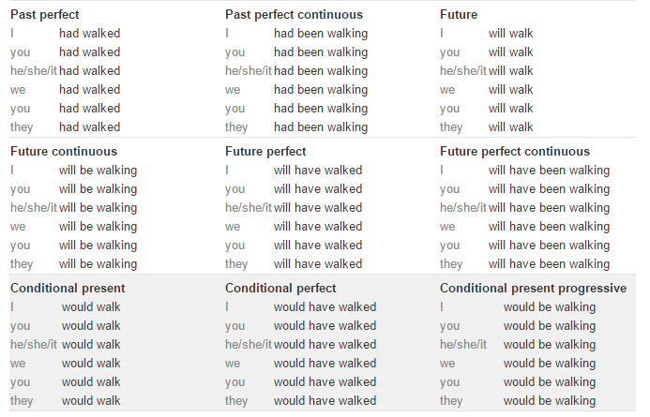
Think of all the different possible ways to express “to walk” for different times and people.
This isn’t even all of them.

Slide 12
What is the difference between all of those forms?
Speak with the people around you.
What kinds of sentences and situations would you say “walked?”
When would you instead use “walking?”

Slide 13
Which one of these many forms would you teach first?

Slide 14
Most language classes begin with the present because you can use it to discuss things you do in general and things you are doing right now.

Slide 15
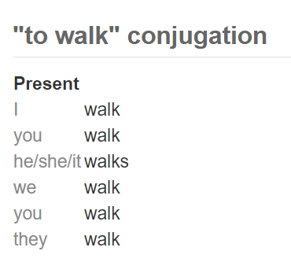
So…how do we get from “to walk” to all of those different forms?
Said another way: why isn’t it…
I to walk
You to walk
He/she/it to walk
What are the rules we used to get from that to this

Slide 16
The rules:
Start with “to walk” to walk
Remove “to” to walk
Add what’s left (walk) to each person I walk You walk He/she/it walk We walk They walk
For he/she/it, add an –s I walk You walk He/she/it walks We walk They walk Now you’re done! You have a correctly formed English verb.

Slide 17
You often see them in a table like this.
This side of the chart is for one person
This side of the chart is for 2+ people
“base form” of the verb
To walk
I talk | We talk
You talk | You all talk
He/she/it talks | They talk

Slide 18
Do a few on your own
To see
I | We
You | You all
He/she/it | They
To watch
I | We
You | You all
He/she/it | They

Slide 19
Do a few on your own
To see
I see | We see
You see | You all see
He/she/it sees | They see
To watch
I watch | We watch
You watch | You all watch
He/she/it watches | They watch

Slide 20
Let’s get irregular. Try applying the rules we just established to these and see what happens.
To have
I | We
You | You all
He/she/it | They
To be
I | We
You | You all
He/she/it | They

Slide 21
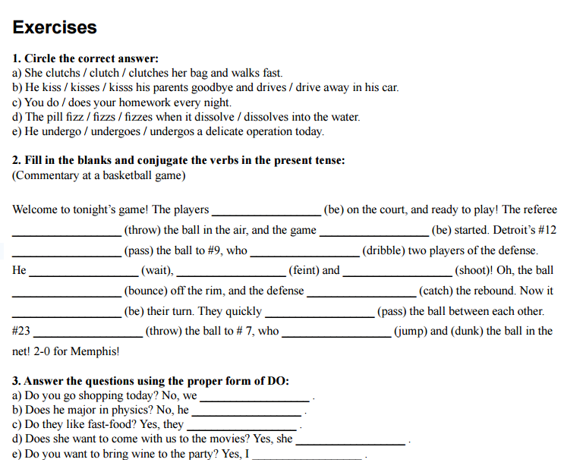
Learners of English might even do a worksheet like this one:
Enjoy easy worksheets while they last. Work with the people around you to complete this.

Slide 22
Let’s sum this up.
If you were learning English, you would learn words in categories.
Verbs (Actions)
Adverbs (describers of actions)
Nouns (things, stuff, people)
Adjectives (describers of stuff)
Everything else
You would start with verbs because they are the most important.
You would start with present tense verbs because they are simple and versatile.
You would learn that you start with a base form “to _____” and use certain rules to make it work with different subjects (I, you, he, she, we, etc.)
You would learn that certain verb families use slightly different rules. For example, some verbs in English add just an –s to “he/she” whereas others add “-es” or change entirely.
When you finished learning these verbs, you would move on to the past tense.

Slide 23
Some final questions
Do you think it would be easy or hard to learn English verbs? Why or why not?
Do you think French verbs are easier or harder?

Slide 24
Warmup
What is a verb? Give an example in English.
Can you give some different forms of that verb?
Can you think of an example of a verb in French?

Slide 25
Yesterday, we learned there were families of English verbs.
We had verbs that only added –s in the present tense:
I walk, you walk, he/she walks
We had verbs that added –es instead:
I do, you do, he/she does
And we had verbs that were totally weird:
I am, you are, he/she is

Slide 26
Today, we are going to talk about the French verbs that are the most “normal”
Much like we group English verbs by patterns, we group French verbs by patterns.
“ER” pattern verbs are the most common (and easy) in the French language.

Slide 27
English has “base form” verbs that start with “to _________”
To go
To do
To walk
To see

Slide 28
In French, those base forms are a single word. How many –ER verbs can you name?
Regarder- to watch
Parler- to talk
Arriver- to arrive
Habiter- to live
Manger- to eat

Slide 29
What are the rules we need to apply in order to use “regarder?”
You can’t say “I to watch” anymore than you can say “je regarder.”
Therefore there had to be a set of rules, just like in English how we remove “to” and add –s to he/she.

Slide 30
The rules:
Start with “regarder” regarder
Remove “er” regarder
Add what’s left (walk) to each person Je regard tu regard Il/elle/on regard Nous regard Vous regard Ils/ells regard
Add –e for je,
-es for tu,
-e for il/elle,
-ons for nous,
-ez for vous,
and –ent for ils/elles. Je regarde tu regardes Il/elle/on regarde Nous regardons Vous regardez Ils/ells regardent

Slide 31
Here’s your end product: a French ER verb in the present tense.
Regarder
Je regarde | Nous regardons
Tu regardes | Vous regardez
Il/elle regarde | Ils/elles regardent

Slide 32
Can someone come up and do one for us?
Marcher
Je | Nous
Tu | Vous
Il/elle | Ils/elles

Slide 33
Comparing to English: which is easier?
To watch
I watch | We watch
You watch | You all watch
He/she watches | The watch
Regarder
Je regarde | Nous regardons
Tu regardes | Vous regardez
Il/elle regarde | Ils/elles regardent

Slide 34
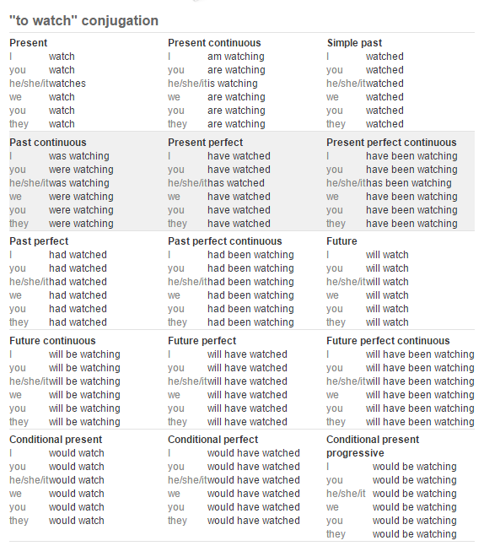
Let’s compare more. Remember looking at all the forms of an English verb?
This website has 21 different verb forms for English.

Slide 35
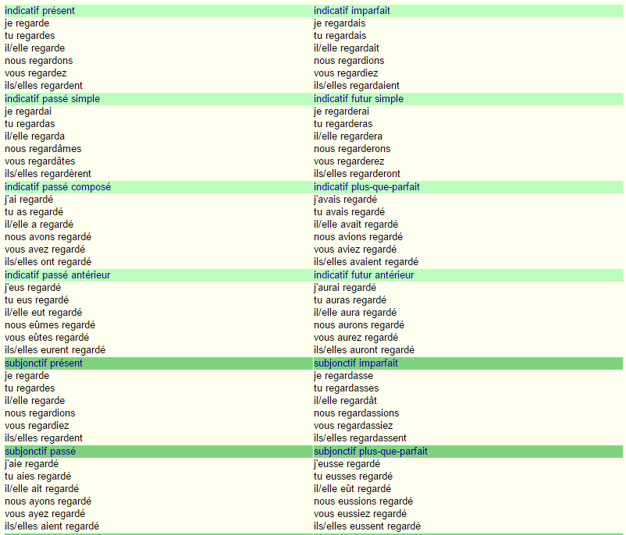
Let’s do the same for French.
This website shows 20 for French.
The good news? 4 or 5 of them are basically dead tenses.
The even better news? You can be conversational knowing only 3 of them and fairly fluent knowing only 5

Slide 36
Let’s compare again.
English has around 21 verb forms (tenses), and all of them are used today.
French has around 15 verb forms (tenses) in use today.
How does French manage to be a language missing 6 verb tenses that we English speakers use all the time?
For example, French has no –ING forms
There is no “I am going” or “he was doing” or “she would be doing”

Slide 37
French achieves this by rolling multiple forms into one.
I watch (in general)
I am watching (right now) Je regarde
I do watch (don’t say I don’t!)
Do you think this makes French easier or harder to learn?

Slide 38
We got off topic there for a while. Let’s return to regular French –ER verbs.
Regarder
Je regarde | Nous regardons
Tu regardes | Vous regardez
Il/elle regarde | Ils/elles regardent
Like this one!

Slide 39
What we now have to realize is that every form of this verb means 3 things in English.
Regarder
Je regarde I watch, I am watching, I do watch | Nous regardons
Tu regardes You watch, you are watching, you do watch | Vous regardez
Il/elle regarde He watches, he is watching, he does watch… | Ils/elles regardent
Fill in the rest of these in your verb reference guide.

Slide 40
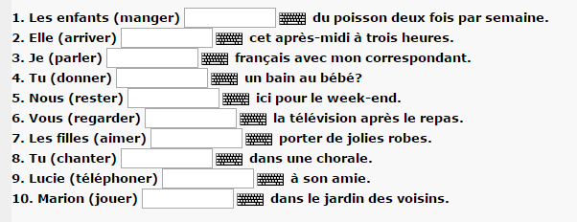
Remember when we did a worksheet for English learners? Now let’s do that in French.

Slide 41
Final note: it’s very tempting to try to translate English word-for-word into French.
We think “I am watching” and we want a three word translation into French with “je suis…regarder-ing”
You don’t need one. Just je regarde is good enough.

Slide 42
Warmup: remember English verb families?
We had verbs like “to walk” which looked like this:
I walk, you walk, he/she walks
We also had verbs like “to watch” where we had to remember an extra “e”:
I watch, you watch, he/she watches

Slide 43
Today we will discuss the 2nd verb family, -RE verbs.
Although this verb family doesn’t have nearly as many members as –ER verbs, some of the members are really important everyday verbs.
Vendre = to sell
Attendre = to wait
Descendre = to take down, to go down
Entendre = to hear
Défendre = to defend
Perdre = to lose
Répondre= to answer, respond
Rendre = to hand in, to turn in

Slide 44
You conjugate them a lot like –ER verbs.
ER verb endings: e, es, e, ons, ez, ent
RE verb endings: s, s, __, ons, ez, ent
Just like you have to chop off the –ER before you add –ER verb endings, you need to remove the –RE before you add those endings.

Slide 45
Fill it in on your important verb sheet
Entendre
J’entends I hear, I am hearing, I do hear | Nous entendons We hear, we are hearing, we do hear
Tu entends You hear, you are hearing, you do hear | Vous entendez You all hear, you all are hearing, you all do hear
Il/elle entend He hears, he is hearing, he does hear | Ils/elles entendent They hear, they are hearing, they do hear

Slide 46
Let’s talk pronunciation.
Much like –ER verbs, all the singular endings are silent.
Je regarde, tu regardes, il regarde = all pronounced “ruh-gard”
J’entends, tu entends, il/elle entend = all pronounced “awntawn”
The plural endings are exactly the same.
Nous regardons, vous regardez, ils/elles regardent
Nous entendons, vous entendez, ils/elles entendent
This means that pronunciation-wise, -ER and –RE verbs are the same in the present. Only spelling is different!

Slide 47
Try a few!
Attendre
Vendre

Slide 48
Try a few!
Attendre
J’attends | Nous attendons
Tu attends | Vous attendez
Il/elle attend | Ils/elles attendent
Vendre
Je vends | Nous vendons
Tu vends | Vous vendez
Il/elle vend | Ils/elles vendent
Can we pronounce these?
Do we remember all 3 meanings?

Slide 49
Grab a whiteboard, marker, and eraser. (1 per person)
Vendre = to sell
Attendre = to wait
Descendre = to take down, to go down
Entendre = to hear
Défendre = to defend
Perdre = to lose
Répondre= to answer, respond
Rendre = to hand in, to turn in

Slide 50
The final major verb family is -IR verbs.
How many IR Verbs can you remember?

Slide 51
-IR verbs
IR verbs are a great source of free vocabulary words. Can you think of a verb in English that ends in ‘-ish?’ If so, it’s probably an –IR verb in French!
Abolir- to abolish
Accomplir- to accomplish
Bannir- to banish
Démolir- to demolish
Établir- to establish
Finir- to finish
Périr- to perish
Punir- to punish
Polir- to polish

Slide 52
Here are the most common –IR verbs for conversation, and the ones I’ll quiz you on.
Grandir – to grow up
Choisir- to choose
Grossir- to get fat
Maigrir- to get thin
(dés)Obéir- to (dis)obey
Réussir- to succeed
Remplir- to fill
Finir- to finish
Définir- to define

Slide 53
Present tense endings:
ER verb endings: e, es, e, ons, ez, ent
RE verb endings: s, s, __, ons, ez, ent
IR verb endings: is, is, it, issons, issez, issent
How they’re actually pronounced: i, i, i, isso, issé, iss

Slide 54
Pronounciation
Once again, we have three basically null singular endings. They are all pronounced the same way: “eeee”
The plural endings are just the –ER and –RE endings, with “ISS” on the front.

Slide 55
Finir
Je finis | Nous finissons
Tu finis | Vous finissez
Il/elle finit | Ils/elles finissent

Slide 56
You know what it is
Punir
Réussir

Slide 57
*There are also a lot of irregular –IR verbs that conjugate like –RE or –ER verbs:
Courir- to run (cours, cours, court, courons, courez, courent)
Partir- to leave (pars, pars, part, partons, partez, partent)
Dormir- to sleep (dors, dors, dort, dormons, dormez, dorment)
Sortir- to go out (sors, sors, sort, sortons, sortez, sortent)
Offrir- to offer (offre, offres, offre, offrons, offrez, offrent)
Ouvrir- to open (ouvre, ouvres, ouvre, ouvrons, ouvrez, ouvrent)

Slide 58
Grab a whiteboard, marker, and eraser. (1 per person)

Slide 59
Trouvez un “whiteboard” !
Grandir – to grow up
Choisir- to choose
Grossir- to get fat
Maigrir- to get thin
(dés)Obéir- to (dis)obey
Réussir- to succeed
Remplir- to fill
Finir- to finish
Définir- to define

Slide 60
Avoir

Slide 61
What does “avoir” mean? Can we remember how to conjugate it?
Avoir: _________
J’ | Nous
Tu | Vous
Il/elle | Ils/elles

Slide 62
Traduisez les phrases avec vos partenaires.
I have a dog
You have a brother.
He has a chromebook
She has a can of soda
We have a homework assignment
You (plural or formal) have a problem.
They have a lot of friends.
They have a pizza
J’ai un chien.
Tu as un frère.
Il a un Chromebook.
Elle a une canette de soda.
Nous avons un devoir.
Vous avez un problème.
Ils ont beaucoup d’amis.
Elles ont une pizza.

Slide 63
Do we know how to make those sentences negative?
J’ai un chien.
Tu as un frère.
Il a un Chromebook.
Elle a une canette de soda.
Nous avons un devoir.
Vous avez un problème.
Ils ont beaucoup d’amis.
Elles ont une pizza.
Je n’ai pas de chien
Tu n’as pas de frère
Il n’a pas de chromebook.
Elle n’a pas de canette de soda.
Nous n’avons pas de devoir.
Vous n’avez pas de problème.
Ils n’ont pas beaucoup d’amis.
Elles n’ont pas de pizza.

Slide 64
Formula
Avoir un __
Avoir une ___
Avoir des ___
Etc.
To have a/some ____
n’ (form of avoir) pas de ____
To not have any _____
negative

Slide 65
Fill in Green Avoir sheet together
Avoir: to have
J’ai | Nous avons
Tu as | Vous avez
Il/elle a | Ils/elles ont The “s” becomes a “z” sound

Slide 66
What is a verb? Give an example in English and French.

Slide 67
How do we show when a verb is happening?
Yesterday, I [to walk] to school
Right now, I [to walk] to math class.
Tomorrow, I [to walk] to the grocery store.

Slide 68
Let’s focus on what we do to a verb in English to show that it is COMPLETE and in the past.
To walk
We can add “-ed” to show the action is finished.
I walked to school. Now I am in class.
We can use “to have” + “-ed” to express that we have experience doing an action.
I have walked to school many times, don’t worry.
We can use “did” + verb to be argumentative.
“Despite what he said, he did walk to school on the 24th.”

Slide 69
Once again, all three of those meanings boil down to just one form in French.
PRESENT
I watch
I am watching
I do watch
PAST
I watched
I have watched
I did watch
PRESENT
Je regarde
PAST
J’ai regardé

Slide 70
How do you make the passé composé?
For one, it’s called the passé composé because the action has passed (passé) and it is composed (composé) of two words.
Step one is to choose the correct form of avoir.
Step two is to put the modified version of the verb after the form of avoir.
ER verbs replace ER with É
RE verbs replace RE with U
IR verbs replace IR with I
Avoir: to have
J’ai | Nous avons
Tu as | Vous avez
Il/elle a | Ils/elles ont

Slide 71
Parler: to talk (past tense)
J’ai parlé I spoke, I have spoken, I did speak | Nous avons parlé
Tu as parlé You spoke, you have spoken, you did speak | Vous avez parlé
Il/elle a parlé | Ils/elles ont parlé
Finir: to finish (past tense)
J’ai fini | Nous avons fini
Tu as fini | Vous avez fini
Il/elle a fini | Ils/elles ont fini
Perdre: to lose (past tense)
J’ai perdu | Nous avons perdu
Tu as perdu | Vous avez perdu
Il/elle a perdu | Ils/elles ont perdu

Slide 72
Which of the three forms does the French look most like?
J’ai regardé I watched / I have watched / I did watch

Slide 73
Translate
J’ai travaillé ______________, ________________, ________________
Elle a joué ______________, ________________, ________________
Nous avons vendu ______________, ________________, ________________
Elles ont défendu ______________, ________________, ________________
Vous avez réussi ______________, ________________, ________________
J’ai maigri ______________, ________________, ________________

Slide 74
Go from present to past.
Je marche. __________________
Elle parle. __________________
Nous rendons. __________________
Vous entendez. __________________
Il finit. __________________
Tu remplis. __________________

Slide 75
Translate
I worked ___________________________
He has finished ___________________________
We did play ___________________________
He has grown up. ___________________________
I waited. ___________________________
We have chosen. ___________________________

Slide 76
IRREGULARS

Slide 77
*Not all English verbs can just add -ed
To walk – I walked, I have walked, I did walk (-ED family)
To speak- I spoke, I have spoken, I did speak (-EN family)
To drink- I drank, I have drunk, I did drink (internal vowel change)

Slide 78
Not all French verbs follow the same passé composé rules
Mettre goes to “mis” and not mettu
Voir goes to “vu” and not voi
From now on when I teach a verb, I will also give you the participle, just in case it’s irregular, so that you can memorize them together.

